Slide 1
BSS OSS Case Study
- Prakash Kajave

Slide 2
Objectives
In this session, you will be able to:
  End to end flow of service fulfillment
  Walk though different system involved during service fulfillment
  Understand the role of AXIOSS, NetSpan, Oracle Portal, Geneva in solution architecture
CONFIDENTIAL© Copyright 2007 Tech Mahindra Limited

Slide 3
Agenda
Order: EasyST Product - Forward Flow
CONFIDENTIAL© Copyright 2007 Tech Mahindra Limited

Slide 4



Order: EasyST Product - Forward Flow
Network Element
Stats Service
Activation
Network Element
6
Activation Engine
Talks with Network and sends
MML commands
NetSpan [ Activation]
AXIOSS O2S – Provisioning
Work Flow started
Talks with NetSpan
5
AXIOSS – O2S [ Provisioning]
4
3
AXIOSS ASI – Inventory Update
Order Status: Open
Product Status: Null
AXI OSS – ASI [ Inventory]
2
Order Validation
Address Validation
Service Availability
J2EE [EAI]
1
Place Easy ST Order
PostCode, Product Profile
Checks Service Availability
Info: MAC, Cust Info
Order ID: XXXX generated
Oracle Portal [CRM]
CONFIDENTIAL© Copyright 2007 Tech Mahindra Limited
Notes:
Pre-requisite
Geneva SP Configured , Replicated in ASI Subscriber Inventory, SP registered in Pipex Web portal , Various SP users with role created

Slide 5

Order: EasyST Product - Reverse Flow
Network Element
Activates the Service
Network Element
7
Network elements activates
Service & Sends response
back to NetSpan
NetSpan
NetSpan talks with AXIOSS O2S (Provisioning) & ASI (Inventory) & updates status
8
AXIOSS – O2S
ASI: updates Inventory
O2S updates following
Order Status: Complete
Product Status: Active
9
10
AXI OSS - ASI
ASI Updates J2EE
App Server Ass Ser.
Updates Order
11
J2EE
Geneva
12
Product Instance created
In Geneva with Active
Status
View Order XXXX
From Portal
Oracle Portal
CONFIDENTIAL© Copyright 2007 Tech Mahindra Limited

Slide 6
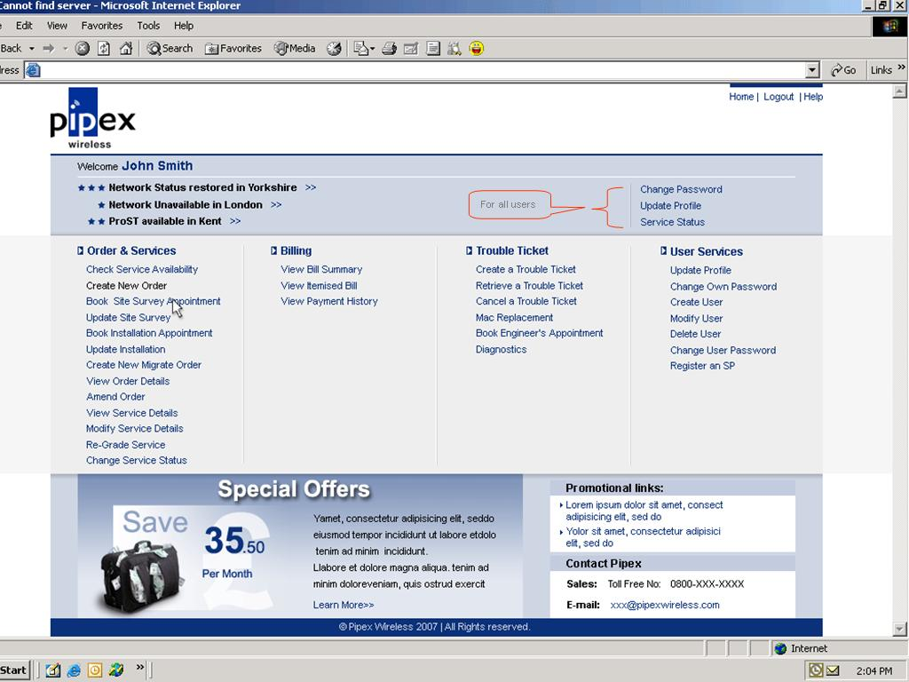
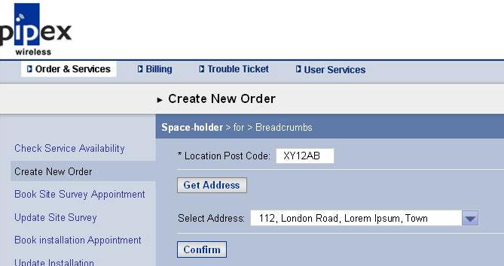
Easy ST Order Capture : Oracle Portal
Order Capture in Oracle Portal
Select Area of Service
CONFIDENTIAL© Copyright 2007 Tech Mahindra Limited

Slide 7
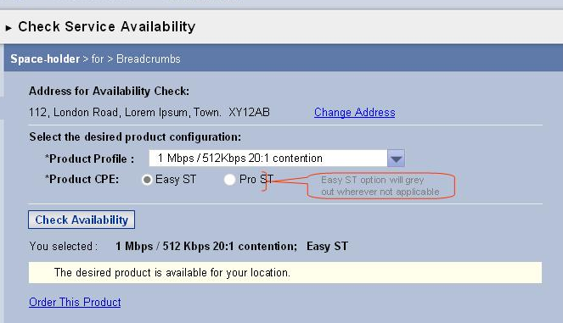
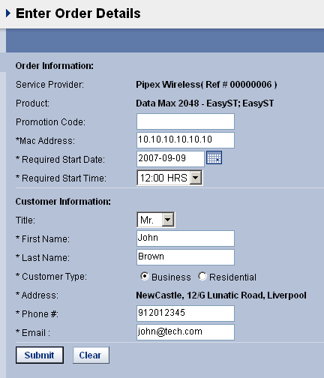
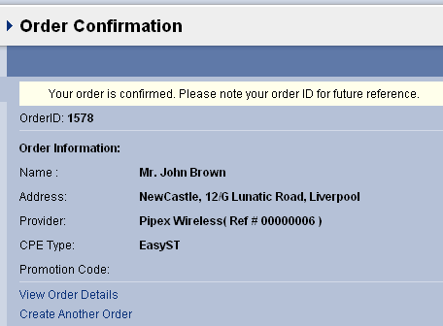
Easy ST Order : Oracle Portal contd..
Order Capture in Oracle Portal
Select Product Profile
Capture other details
Order ID created
CONFIDENTIAL© Copyright 2007 Tech Mahindra Limited

Slide 8
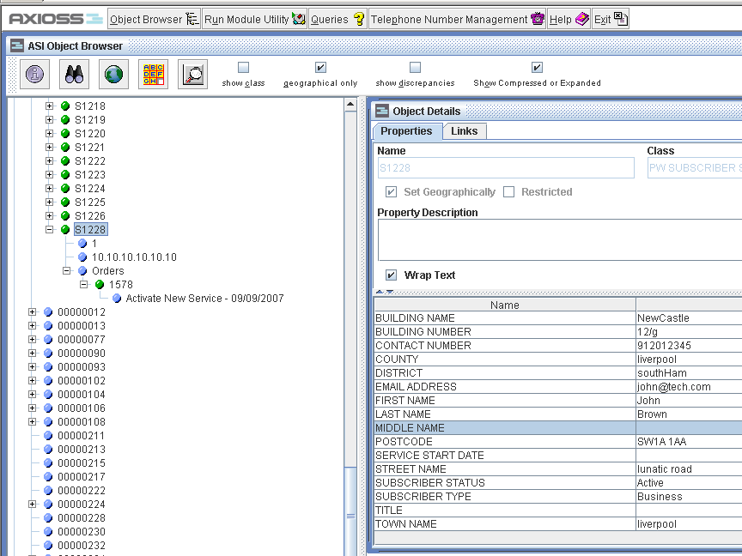
Easy ST Order in AXIOSS ASI
AXIOSS
ASI – Service Inventory
Order in AXIOSS ASI
Initial Status: Pending
Final Status: Active
Service Inventory
CONFIDENTIAL© Copyright 2007 Tech Mahindra Limited

Slide 9
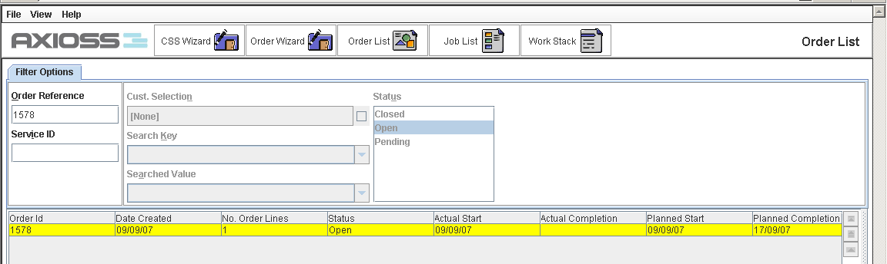
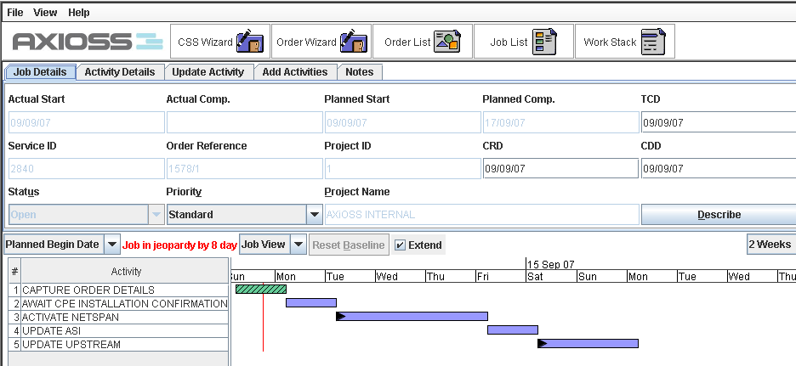
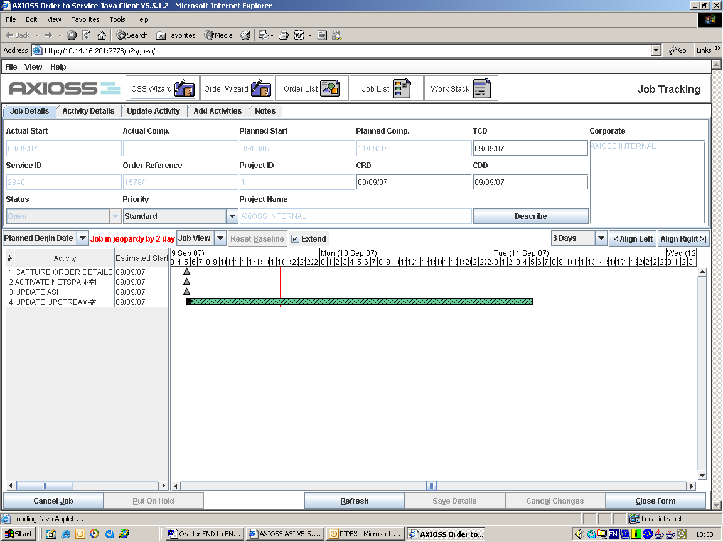
Easy ST Order in AXIOSS O2S
AXIOSS
O2S – Service Provisioning
Progress of Order Activity
Activity Started
Activity almost Finished
Order in O2S
Order is broken down in activities / tasks
Activities / tasks are generally automatic
CONFIDENTIAL© Copyright 2007 Tech Mahindra Limited

Slide 10
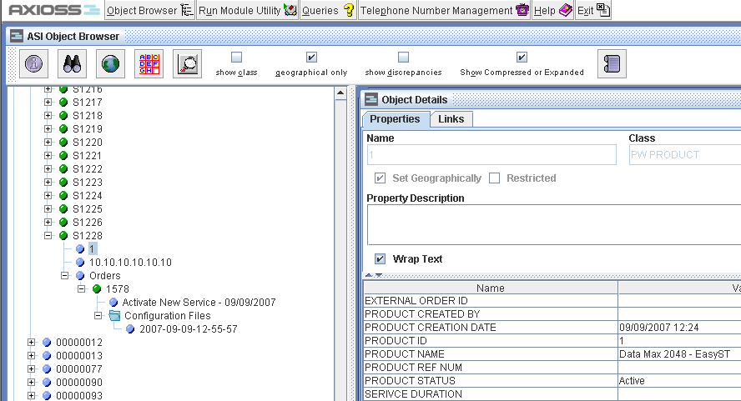
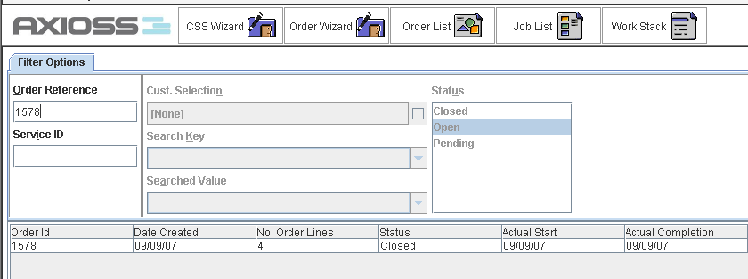
Easy ST Order : ASI and OSI reflection
AXIOSS
O2S – Service Provisioning
AXIOSS
ASI – Service Inventory
AXIOSS
O2S – Service Provisioning
CONFIDENTIAL© Copyright 2007 Tech Mahindra Limited

Slide 11
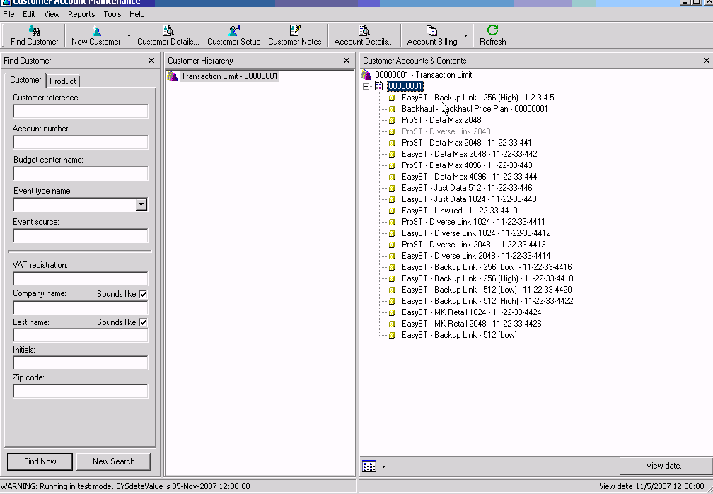
Easy ST Order : Geneva reflection
Customer, Account & Product in Geneva
Product is added in Geneva for a particular end customer through API
CONFIDENTIAL© Copyright 2007 Tech Mahindra Limited

Slide 12
Summary
In this session, we covered:
  End to end service fulfillment scenario of service order
CONFIDENTIAL© Copyright 2007 Tech Mahindra Limited

Slide 13



Any Queries …
&
Questions
Answers
CONFIDENTIAL© Copyright 2007 Tech Mahindra Limited

